Slide 1





Governing Documents and Key Policies
Understanding Legal Structures and Policies Part 2 of 2
highlandtsi.org.uk
info@highlandtsi.org.uk
01349 864289

Slide 2

Session Aims
To give you a foundation understanding of the difference between a governing document, policy and procedure
Help you develop a process for keeping documents controlled and up to date
Give you a way to identify what you really need and what is good to have

Slide 3
Why do you need Governing Documents, Policies and Procedures?
Establish a framework for how your group operates
Define how a group will manage itself
Illustrate how a group meets its regulatory requirements
Demonstrate to stakeholders and funders accountability and compliance
Provide standards of conduct
Identify controls for delegation to staff or volunteers - setting out how things should be done and what is expected

Slide 4
A governing document (referred to as a constitution, memorandum and articles of association, trust deed) sets out the rules by which a group is run.
A policy sets out how an organisation intends to conduct its services, actions or business, particularly in response to legislation and regulatory requirements.
A procedure defines how certain activities happen these will show:
Who will do what
What steps they need to take
Which forms or documents to use

Slide 5
How to control documents
To ensure all documents are appropriate and up to date. It is recommended you keep a document control sheet that shows
Title of document | Date signed off | Location of the document | Next review date
All documents have a standard file naming system that helps to identify them
Skye and Lochalsh CVO Health and Safety Policy July 2019
All documents have a version control system
Date Created: 02/11/2016 Date Reviewed: July 2019 Date Authorised by Board: July 2019

Slide 6
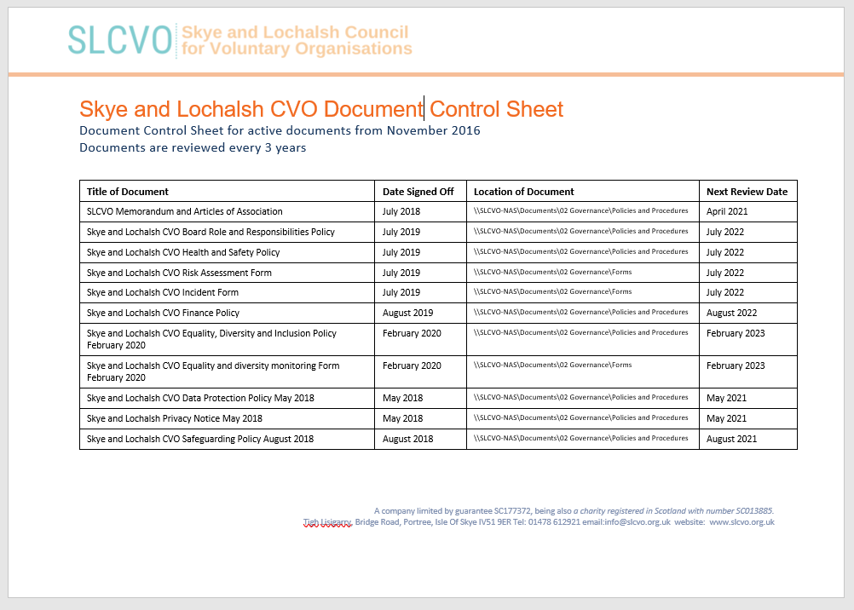

Slide 7
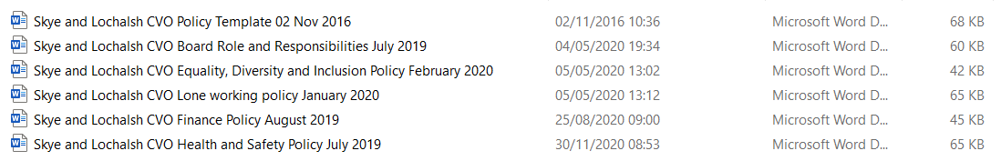
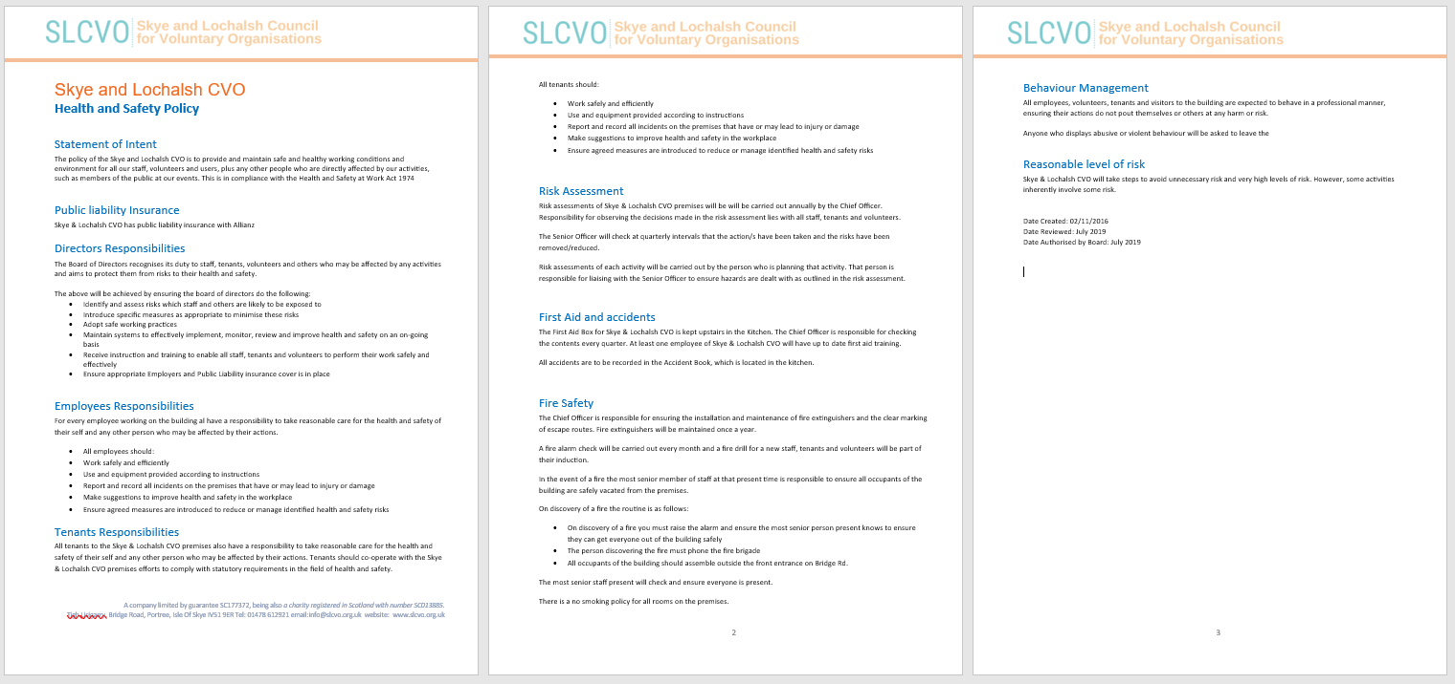


Slide 8
Developing Governing Documents
The most important document for a community group is its governing document. It sets out the rules by which an organisation will run including:
  The activities the group can be involved in
  The geographic area the group will operate within
  The qualification, application and termination rules for membership
  What membership entitles people to i.e. voting rights
  Election, retirement and termination rules of the management committee
  The powers of the management committee and office bearers
  The rules for running meetings including quorum and voting procedures
  Financial requirements
  Winding down the organisation

Slide 9
Developing Policies and Procedures
Using a standard template will ensure your documents are easy to understand and consistent. A policy or procedure should include as the minimum:
  Title
  Statement of Purpose/Intent i.e. what is the document for and reason for having it (relevant legislation)
  Policy/Procedure details i.e. who will do what, what steps they need to take, which forms/documents to use etc.
  Version Control information
  Organisation details including charity/company number and contact details

Slide 11
?
?
Disciplinary and Grievance Policy
Volunteer role descriptions
?
Lone worker Policy
Board Roles and Responsibilities
Health and Safety Policy
Safeguarding Policy
?
Use of office equipment/ own equipment Policy
?
Financial Policy
?
?
Volunteer Policy
Volunteer agreements
?
What Policies do you really need?
?
Employment Polices
Adverse weather and travel disruption Policy
Complaints Policy internal and external
?
?
Equality & Diversity Policy
?
Risk Assessments
Communications Policy
Data Protection Policy (GDPR)
Infection Control Policy
?

Slide 12
Key Questions
What does your group do?
Who does your group work with?
Is there specific legislation covering your activities?
Are you accountable to that legislation?
Is there standard good practice guidance for your activities?
Should you follow this?
Do you need to show your compliance?

Slide 13
What does your group do and who does it work with?
What is your legal structure?
Are you a charity?
Do you employ people?
Are you responsible for premises?
Do you hold personal information about people?
Do you have a mail list of members?
Do you obtain funds through fundraising activates?
Do you have volunteers?
Do you work with people who have protected characteristics?
Do you work with vulnerable groups

Slide 14
Examples of Legislation
Legal Structure | Companies Act 2006, The Charities and Trustees Investment (Scotland) Act 2005
Employ People | The Equality Act 2010, The Health and Safety Act 1974
Premises | The Health and Safety Act 1974
Personal Information | The Data Protection Act 2018 and GDPR
Mail Lists | Privacy and Electronic Regulations 2003
Fundraising – raffles | The Gambling Act 2005
Protected characteristics | The Equality Act 2010
Vulnerable groups | The Protecting Vulnerable Groups (Scotland) Act 2007

Slide 15
Are you accountable to the legislation?
The Health and Safety Act 1974
  Employ people or are responsible for premises specific legal requirements NEED a Health and Safety Policy
  Do not employ people or have premises – GOOD TO HAVE a policy to show how you ensure the welfare of volunteers, members, participants and general public
How do you know what you need?
  Health and Safety Executive https://www.hse.gov.uk/scotland/
  Information Commissioner Office https://ico.org.uk/
  OSCR https://www.oscr.org.uk/
  Companies House https://www.gov.uk/government/organisations/companies-house
  Equality and Human Rights Commission https://www.equalityhumanrights.com/en
  ACAS https://www.acas.org.uk/
  Disclosure Scotland https://www.mygov.scot/about-disclosure-scotland/

Slide 16
Examples of Good Practice Frameworks
Volunteers | Volunteer Scotland - for volunteering policies and procedures https://www.volunteerscotland.net/for-organisations/
Governing bodies | Scottish Council for Voluntary organisations https://scvo.org.uk/support/running-your-organisation/governance/roles-responsibilities OSCR Guidance and good practice for Charity Trustees https://www.oscr.org.uk/guidance-and-forms/guidance-and-good-practice-for-charity-trustees/
Social Care and Social Work groups | Care Inspectorate – The Hub https://hub.careinspectorate.com/

Slide 17
Recap
To give you a foundation understanding of the difference between a governing document, policy and procedure
Help you develop a process for keeping documents controlled and up to date
Give you a way to identify what you really need and what is good to have
  Governing Document
  Roles and Responsibilities of Members
  Roles, Responsibilities and Powers Governing Body
  Financial Management
  Fundraising, Income Generation, Grant Funding
  Data Protection
  Health and Safety
  Safeguarding
  Volunteers – recruitment, roles, responsibilities, supervision
  Staff – recruitment, equality, roles, responsibilities, supervision

Slide 18

Where to get help https://www.highlandtsi.org.uk

Slide 19
Use them
Read and understand them
Give to staff and volunteers - induction
Illustrate to funders or those commissioning services compliance
Keep them up to date

Slide 20

THANK
YOU
highlandtsi.org.uk
info@highlandtsi.org.uk
01349 864289
The Highland Third Sector Interface is a Scottish Registered Charity SC043521 and a Scottish Registered Company SC425808

