Slide 1
16 & 17 April 2025
Notes:
Welcome and start recording --- This presentation aims to provide an overview of the Community Link Worker Third Sector Fund, focusing on its purpose, target organizations, application process, and funding criteria. It is designed to inform stakeholders about the opportunities available for third sector organizations to enhance health and wellbeing in communities.

Slide 2
Agenda
Funding Overview
Target Areas
Service Scope
Application Process
Funding Criteria
Financial Breakdown
Grant Arrangements
Reporting
Notes:
In this presentation, we will cover several key areas, including an overview of the fund, the target areas for funding, the service scope, the process, criteria on which applications will be assessed, and details on grant distribution. We’ll also take a moment to prepare you for the financial details that will be required within the application and the evaluation expected of successful applicants. And we will have plenty time after the presentation to take your questions.

Slide 3
Funding process
Total Fund Amount
Courtesy of NHS Highland, HTSI has over £75,000 to support third sector organisations in Highland. This is intended for specific rural areas in Highland which had not been part of the social prescribing programme until last year.
Purpose of Grants
The funds will be allocated as one-off grants of <£10,000 to help increase capacity in communities between 2025 and 2027. The aim is to improve access to support to facilitate social prescribing in your area, reducing health inequalities and addressing social issues.
Reporting and Results
Third sector organisations will report their outcomes to HTSI, including evidence of the difference made for individuals, and ensure organisations are supported to deliver services and evaluate impact.
Notes:
Courtesy of NHS Highland, HTSI has over £75,000 to distribute to third sector organisations in specific areas of Highland. These areas have not been part of the social prescribing programme from the beginning, and these communities have specific rural health challenges.
Grants will be one-off up to £10K maximum, to be spent between now and end March 2027. The aim is to improve access to support and facilitate social prescribing in your area, reducing health inequalities and addressing social issues. The amount requested should be led by the proposed activities including full cost recovery. Claiming for overheads or management fees must be justifiable, reasonable and not covered elsewhere by core funding or other grant schemes. Please ensure there’s no overlap and that you have everything else in place to deliver, besides the investment.
Successful applicants would report to HTSI and results will be collated for NHS Highland. And of course, as part of our support to TSOs we will ensure that you are supported to deliver services and evaluate impact.

Slide 4
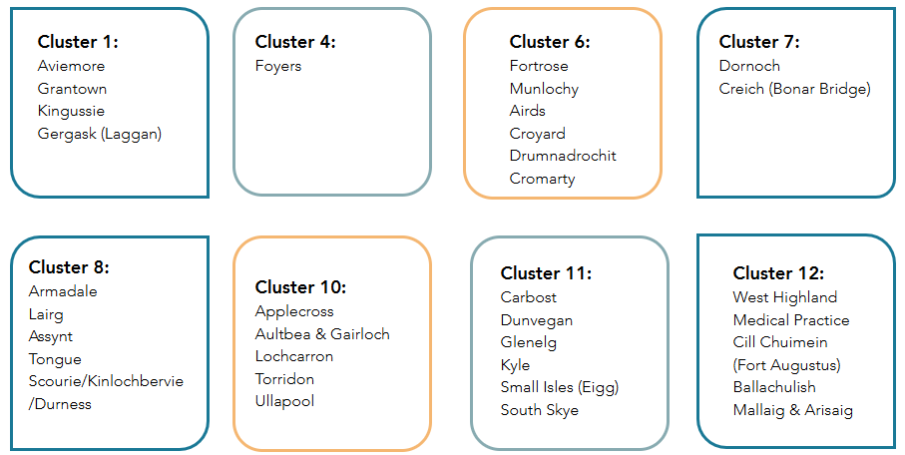
GP CLUSTERS
Notes:
Here are the geographic communities targeted for this fund, which were part of the recent expansion of social prescribing in NHS Highland. Whereas some areas of Highland have had CLWs for a few years now, these clusters have had less time to develop services to meet the needs being identified by CLWs and are generally speaking, less populated. So, hopefully you can see the rationale behind offering funds to address rural health inequalities.

Slide 5
Social Issues Impacting Health and Wellbeing
Housing Issues
Housing issues can lead to significant stress and negatively affect overall health and wellbeing.
Employment and Learning
Access to employment and learning opportunities is crucial for financial stability and personal development, impacting mental health.
Support Groups
Support groups provide individuals with community and resources to cope with various health issues, enhancing emotional wellbeing.
Physical Activity
Regular physical activity is essential for maintaining physical and mental health, reducing the risk of chronic conditions.
Money Advice
Alleviating worry about debt and financial obligations can have a huge impact on mental and physical health.
Notes:
Services could potentially cover a wide range of social issues that can impact on health and wellbeing, which may include: · housing issues · employment and learning · long-term conditions, support groups · money worries · physical activity · caring for relatives · social isolation

Slide 6
Guidance
Dedicated Web Page
Provides access to fund guidance, FAQs, and other resources. As soon as we know the panel dates, we will publish these online so you know when to expect a decision.
Online Application Portal
An online application portal streamlines the submission process for applicants, making it more efficient. This same platform will be used for reporting.
Funding Panel and Agreements
HTSI will host a funding panel with health and social care partners to enable collaborative and strategic decision-making.
Evaluation & Monitoring
Establish a reporting schedule and format, collate results and share evidence with NHS Highland.
Notes:
HTSI have designed an application process, which includes: · These online briefings to share the process and criteria · A dedicated web page to share guidance and FAQs · Online application portal · Host funding panel with health & social care partners · Generate funding agreements and issue payments · Establish a reporting schedule and format · Collate reports and share evidence with NHS Highland

Slide 7
eligibility
Bank account in organisation’s name
Fair Work First policy statement
Governance Structure
Notes:
To be eligible to apply, you must have a bank account registered in the organisation’s name.
Applicants must also be able to demonstrate that they comply with the Fair Work First Policy. In line with the Bute House Agreement, the default position is that all grant recipients awarded a public sector grant from 1 July 2023 are required to pay at least the ‘Real Living Wage’ and provide appropriate channels for ‘Effective Workers' Voice’ as a minimum standard. This statement is applicable to all groups and organisations, even if you don’t employ staff and/or only work with volunteers. This requires a statement from the organisation, to confirm that you comply. The guidance is available online, or you can contact us for clarity.
And finally, your organisational structure must be listed in the application under the contact details. If your structure is not listed, there’s a good chance you’re not eligible. Unincorporated Associations will not be eligible to apply for a grant, but you may collaborate with another organisation which has the infrastructure and safeguards to help minimise risk.

Slide 8
Assessment criteria
Evidence of Need
Applicants must demonstrate a clear need within the community and provide evidence of community-led engagement/development.
Experience operating in Highland
Experience in operating services in Highland, particularly with vulnerable populations.
Alignment with Social Prescribing
Proposals must align with the aims and objectives of social prescribing to qualify for funding.
Quality and Viability
Organisations must demonstrate quality, competency, and viability in their proposed services to be considered eligible.
Capacity and Sustainability
The ability to expand existing services while considering long-term sustainability, is important for any organisations looking to enhance community support.
Notes:
Key Criteria you will be assessed on: · Evidence of need and community-led development · Experience operating services in Highland and working with vulnerable people · Fit with the aims of social prescribing
Please consider that while we can fund existing services to expand their capacity or reach, this should be based on need, ie. views captured from participants and their lived experience and show how you plan to implement this and reach more people (ie. working with community link workers). · Quality/competency/viability
We would also like to encourage you to think about collaborating with other community groups, to maximise reach as well as value for money.

Slide 9
Revenue Expenditure
Staff Costs
Include pensions and employers' costs
Professional Fees and Insurances
Room/venue Hire
Regular overheads for project activities
Travel Costs
Volunteer Expenses
Notes:
Revenue expenditure is usually defined as costs incurred for the day-to-day running of a project. It might include staff costs, professional fees, room hire, travel costs, and volunteer expenses. Art materials and refreshments are also revenue items.

Slide 10
capital Expenditure
Funds used to acquire, upgrade, and maintain physical assets, includes buildings, technology, and equipment.
Nature of capital expenditure:
Typically one-time costs
Contribute to long-term value and functionality
Examples of capital expenditure:
Purchase of land
Construction
Renovations
Procurement of technology systems
One-off equipment purchases
Notes:
Capital expenditure usually refers to funds used to acquire, upgrade, and maintain physical assets such as buildings, technology, and equipment. These expenditures are typically one-time costs but contribute to the long-term value and functionality of the project.

Slide 11
Income and Expenditure
Income/expenditure details for the whole organisation:
Figures rounded up to nearest whole number
No currency symbols or text
Financial year ending March 2024
Different 12-month period?
Complete figures for that period
Confirm dates and explain
Allow time to liaise with treasurer or accountant
Notes:
Please provide income/expenditure details for the period ending 31 March 2024 for your whole organisation, not just the department related to this application. Figures should be rounded up to the nearest whole number, with no currency symbols or text.
Please provide information for the financial year (12 months) ending in March 2024, if possible. Ordinarily, this would be the same period as your latest verified accounts cover, but it's not essential if this is not possible. If your organisation's accounts cover a different 12-month period, please complete the figures for that period, confirm the dates and explain. This information is usually accessible through your organisations balance sheet, but if you may need assistance with this part of the form, please make sure you build in enough time to access this from the person who handles your finances, especially if this is external to the organisation. Failure to include this may result in your application not being assessed. We have provided a free text box to provide any explanation required on your accounts. Please note that apart from the financial accounts we ask you to upload before you submit your application, we cannot accept any supporting documents as part of your application. The panel members have to find time to read through all the applications on top of any day job they may have, so it’s important that you consider this when writing your application. This is why we limit word count as well and its up to applicants to find a way to answer the questions and provide supporting statements that fit the prescribed format.

Slide 12
Grant arrangements
Total Grant Amount
The maximum amount you may apply for is £10,000 and it’s up to you to decide what period of time this will cover. You must state in your application an estimated start and end date and inform us if this changes.
Financial Breakdown
You must provide a breakdown of all project costs, even if they won’t be covered by this grant. Then you can tell us the total project costs and amount requested.
Grant Distribution
The funds will be distributed within two weeks of signed funding agreements being returned by the successful applicants.
Communication
All applicants will be notified of decisions, and we will provide feedback. However, please consider that when funds are seriously limited, we set a minimum threshold for shortlisting.

Slide 13
Evaluation & monitoring
Evaluation is about measuring the difference your project makes:
To measure change, you need a baseline and a conclusion as a minimum
The difference should relate to the outcomes you want to achieve
Monitoring is about tracking progress via outputs/activities:
No. of sessions
No. of people (including staff/vols)
Hours of support
Equality Monitoring is about demonstrating inclusion:
Demographics of people engaging with the project
Ensure costs of inclusion reflected in project details
Notes:
We’ve scheduled a training session on Engagement, Evaluation & Funding on 29 May. There’s a discount on the cost of the training for members, and if you’re not a member yet you can sign up online for free.

Slide 14
Contact:
funding@highlandtsi.org.uk
www.highlandtsi.org.uk/clw-remote-rural-fund
Understanding Application Process
A clear understanding of the fund’s criteria and application process is crucial for organisations to benefit effectively from this opportunity.
Support with your application
If you need support or to discuss your proposal, it’s critical that you contact us as early as possible, to enable us to respond in time.
Guidance & FAQs
Please ensure that you have thoroughly checked the documents provided online before asking for support, to ensure that we have not already answered your query.
Notes:
In conclusion, the Community Link Worker Third Sector Fund offers vital support to organisations working to improve health and wellbeing in communities, particularly in remote and rural areas. However, in order to fully benefit from this opportunity, it is crucial that you take the time to understand the fund’s aims, criteria, and application process. I know that many of you don’t have dedicated capacity for funding applications, but any time spent on completing the application form with minimal understanding of the guidance will be time wasted. But if you do take the time to follow the guidance, you will have a much higher chance of success.

