Slide 1

Highland Alcohol & Drugs Partnership
Information Briefing
22 June 2022
Notes:
The Highland Alcohol & Drugs Partnership (ADP) or ‘the partnership’ has awarded a portion of Scottish Government funds for third sector organisations in Highland. And with this briefing session we aim to help you decide if this grant and the aims of this funding are likely to match with your own current priorities, before you apply. And in case you decide to apply, we will also explore the application and assessment process, the amount you can request and how to make the most of this opportunity.
The Local Improvement Fund has previously enabled third sector organisations in Highland to deliver meaningful outcomes, aligned with the region's strategic priorities. However, we recognise the very real pressures organisations currently face around financial uncertainty, capacity and staff wellbeing. In addition, the amount available this year is reduced to £58,500.
Thus, we are inviting applications for capacity building activity, rather than delivering a project for people, so we’re focusing these grants on supporting organisational development, planning and staff wellbeing.

Slide 2
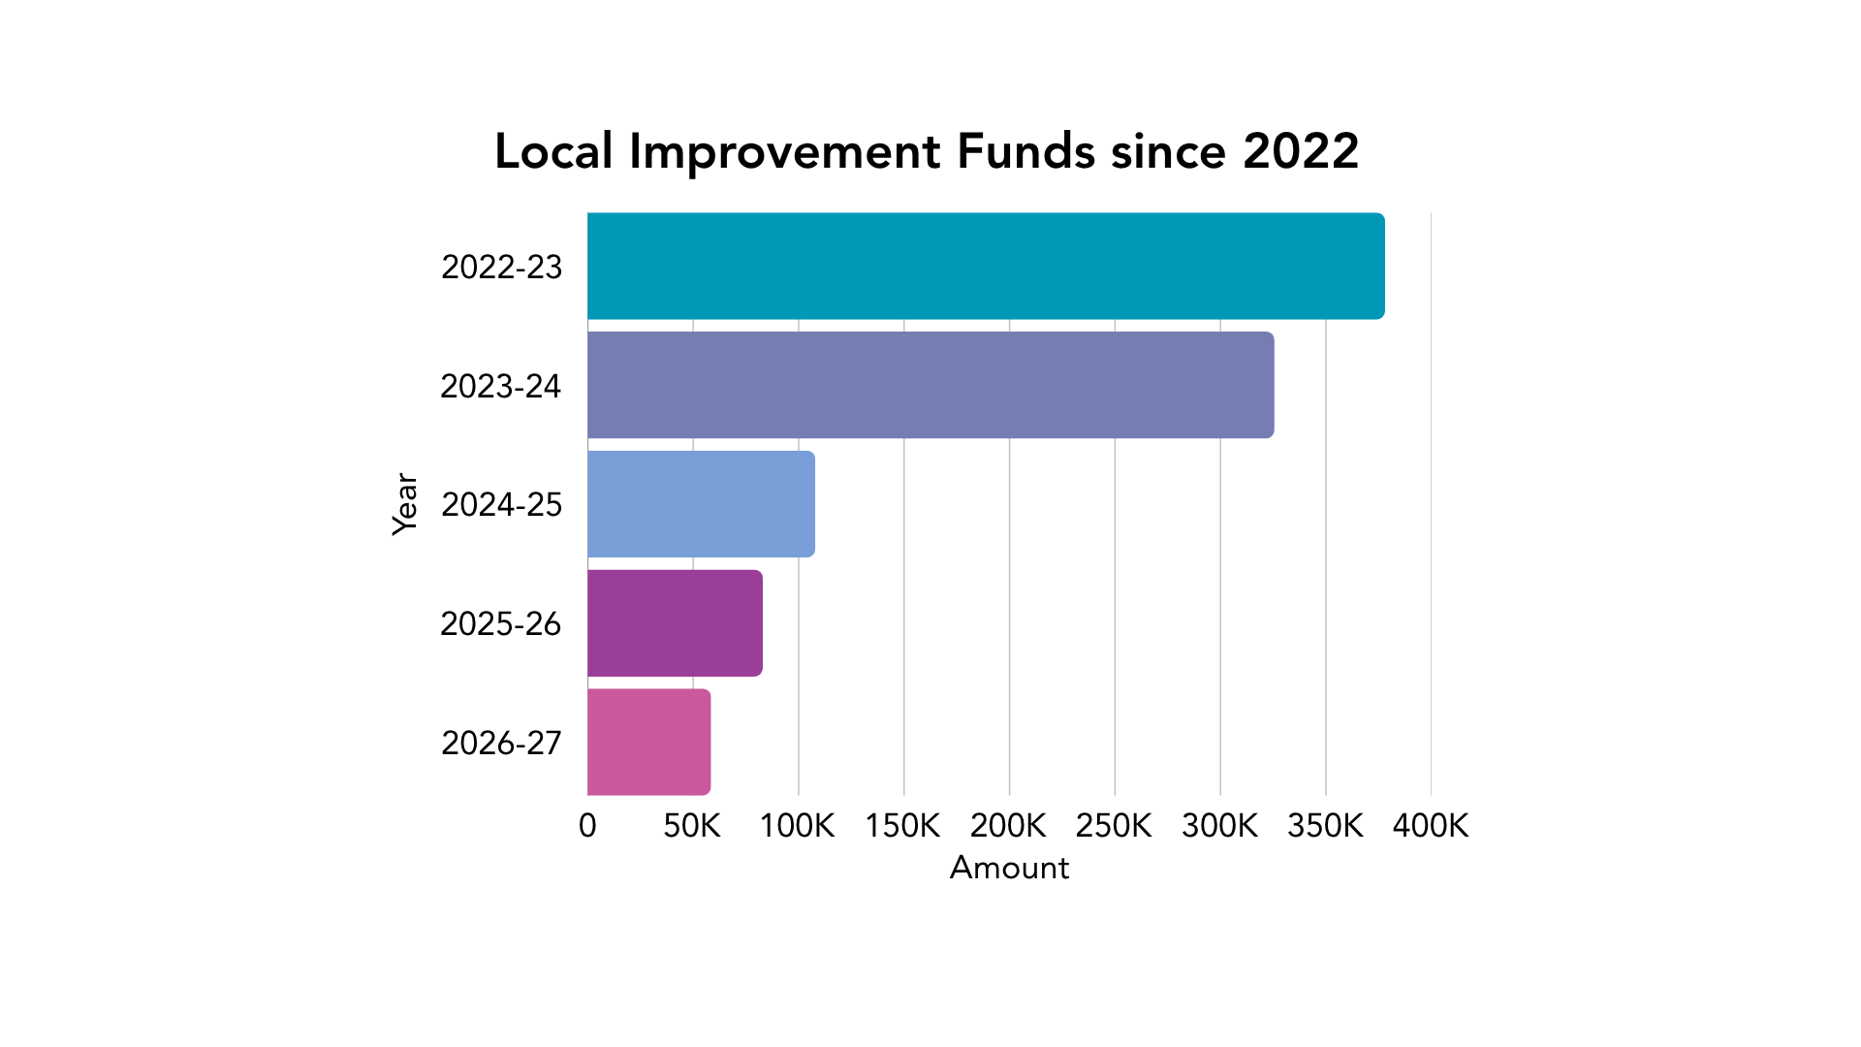

Notes:
As you may know, last year we awarded 9 grants worth £83,000. Added to the funding we previously awarded across the Highlands, investment in this area of work = over £890,000 so far. That’s the total from the Local Improvement Fund grants we’ve distributed so far. And the result has been a wide variety of fantastic initiatives, some of which are still ongoing.
In this graph you can see the relative amounts provided each year, since 2022, which as you can see has reduced significantly – but this in no way reflects the value of, or appreciation for the work being undertaken by the sector. As you may know, some groups are now being commissioned directly by the partnership, for the support they provide. And the ADP are doing what they can to ensure that the funds they receive are targeted at those delivering essential outcomes around prevention and reducing harm.
This year, the amount available is reduced to £58,500, so please only apply for the amount that you need, based on estimated forecast of costs for necessary activity. Accurate estimates not only permit us to share funds with a higher number of organisations, but it also can save a lot of time and effort on managing the subsequent work to tackle under/overspends, with funded projects.
So, as well as describing the application process today, I’ll offer some recommendations for anyone considering applying to this fund, whether that is for the first time or as a repeat customer.
So, we are offering grants of up to £10,000 for organisations involved in supporting the partnership’s strategic plans. However, the majority of grants awarded are likely to be no more than £5,000 due to the limited funds. Applications requesting over this amount must demonstrate a strong rationale for exceptional circumstances.

Slide 3
HADP Strategic Plan
2025–2030
Prevention and Early Intervention
Outcome: Prevent, delay onset, and reduce problem alcohol and drug use
Access to quality alcohol and drugs support and care services
Outcome: Improve access to and benefits from effective, integrated, person-centred, quality, and recovery-orientated systems of care
Harm Reduction
Outcome: Reduce harm and risk experienced by people using alcohol and drugs by increasing availability and access to harm reduction approaches
Whole system support and innovation
Outcome: Make better use of the whole system to meet the needs of people with problem alcohol and drug use
Supporting the workforce
Outcome: Develop a resilient, skilled, trauma-informed workforce that work in trauma-informed places
Effective engagement, delivery and governance
Outcome: Ensure effective engagement, governance and reporting arrangements
Notes:
Highland ADP have set out their vision for what they want to achieve, which tallies with the Scottish Governments vision. And we’d very much like these funds to continue helping to achieve this change.
We provide links to the strategic plan on our web page, as well as in the guidance and FAQs documents. Please explore these thoroughly if you don’t already know them off by heart.

Slide 4
Capacity Building:
Support with leadership and governance
Support with financial plans, systems and infrastructure
Helping organisations develop and plan for the future
Supporting staff and volunteer wellbeing, especially in high-pressure or trauma-informed settings
Other development need
Notes:
Given the reduced amount of funds available and the number of groups we’ve heard from recently who are struggling with capacity, we felt there was a way to use this fund to help overcome some of these issues. Thankfully, the ADP have agreed to this, and we’re offering these grants exclusively for building capacity, strengthening governance and infrastructure, developing robust plans and sustaining staff and volunteer wellbeing for the future. We will also consider other development needs, and you will be expected to engage staff and/or volunteers in devising and delivering changes, and we ask that you please consider what is proportionate to the amount available for the sector in Highland.
So, instead of focusing on how your application can demonstrate direct benefits for your service users, this application is designed to help you demonstrate how you intend to build your capacity to deliver support in the future. The HADP want these funds to strengthen the sector, and you can help demonstrate how this might be achieved.

Slide 5
Application:
OPENING DATE
Closing date
MIDDAY Thursday 26 November
Thursday 22 October
Notes:
The Local Improvement Fund grants will be awarded early in the new year, with a view to projects starting in April (or sooner) and you can deliver your project for up to 12 months. The earlier you can start the better, as we know the need exists now, but it all depends how ready you are to begin. Also, the earlier your project is due to end, if funded groups run into difficulties, we can approve a brief extension till end April 2028 at the latest. So, we’d prefer to maintain a wee bit of flexibility for that reason.
The closing date is 26 November at MIDDAY, which is a Thursday. This allows you five weeks to apply and again, I need to emphasise the application portal will be disabled at midday – and late applications will not be accepted.
We all know that in life, we generally get out what we put in and so, please remember that submitting a funding application can often take longer than expected. There are facts that need to be checked, figures to clarify, criteria to match, and proof reading to make sure that at the very least, your contact details are correct. So, you should aim to set aside sufficient time to devote to reading through the guidance and criteria for this fund, outlining your proposed activity, costing it out based on estimated outputs, such as number of staff, etc, then drafting your application based on the anticipated outcomes and assessment criteria detailed within the guidance.
Once you’ve completed this, you should always leave enough time to ask someone to sense check it for you and once you’ve done your final edit, then you need to ensure it is formatted to make sure it’s clear and easy to follow. There’s no point trying to proof-read a document you’ve spent hours writing and rewriting because you’re very unlikely to notice typos at that point. Make it clear and compelling, persuade the reader that with this funding you can improve your capacity to work collaboratively in the future. Be concise so you can say more with fewer words and don’t make assumptions about what people will already know about your organisation.

Slide 6
Eligibility criteria
Eligible organisation with relevant financial evidence
Works with people affected by alcohol and drugs harms in Highland
Contributing to HADP’s Strategic Priorities
Proposal fits with the aims and scope of the fund
Notes:
Ultimately, the purpose of this funding is to enable the sector to maintain sufficient support that helps prevent or reduce alcohol & drug-related harm, involves people with living/lived experience, provides evidence of both the need and efficacy of the involvement, as well as monitoring and evaluating the difference your service makes.
The application should provide an opportunity to explain how the proposed development plans, further your organisation’s ability to continue this work.
These are the essential criteria for being eligible to apply, in addition to delivering at least one of the capacity building options in the guidance. Any Third Sector organisation or community group can apply as long as you have a bank account in the organisation’s name and accounts from the previous year. You must have experience operating or delivering services and working with people affected by alcohol and/or drugs. Your proposals should be led by and involve staff and/or volunteers.
Fair Work First is a policy that sets out a vision for people in Scotland to have a world-leading working life. Any organisations in receipt of a grant from Scottish Government funds must have a policy statement that outlines how they comply with the fair work framework, unless of course you don’t employ staff. But if anyone is remunerated for delivering services, you must consider how you might apply the principles of Fair Work First to any contractual arrangements. So, these are pre-requisite to completing the application – you must answer this Q about fair work and the Q about a bank account to proceed with the form.
Relevant financial evidence includes a breakdown of costs for your proposal, and end of year figures covering income expenditure deficit and reserves, as well as uploading a matching statement of financial activities. Anyone who can’t provide that for the fiscal year, 2024 - 2025 should get in touch so we can offer guidance covering your specific circumstances. If we were asking for the latest financial year, some orgs would not have accounts verified yet.
It’s also important to have estimated costs breakdown for your proposals and details of any match funding – so long as that funding isn't alcohol industry connected e.g. The Robertson Trust.

Slide 7
Assessment criteria
Applications will be assessed by an independent panel:
Identified need and fit with the fund
Organisational benefit
Additionality
Sustainability and impact
Scale and scope match aims & meets identified needs
Strengthening capacity resilience or wellbeing
Proportionate & necessary improvements
Plans to embed learning, improvements & practices
Notes:
If your application meets the essential criteria this will be assessed by the independent funding panel, which is made up of members of the Highland Partnership, including third sector colleagues, NHS Highland, Highland Council and others. We can offer support with the application process of course, if you contact us in plenty of time. During the first three weeks of the process, we can review applications and offer recommendations, but after this time it becomes unrealistic.
Decisions will be based on how well your application demonstrates that you meet the following criteria:
Is there a clear and evidenced organisational need?
Is there a clear explanation of the difference the support will make?
Are proposed costs reasonable and proportionate to expected benefits?
And are benefits likely to continue beyond the funded activity? Is there a clear plan for this?
We will provide the panel with a scoring system to ensure a consistent process in reaching decisions, so these are the underlying principles on which applications will be assessed.

Slide 8
Questions
Application includes the following questions to ensure you can describe how your proposals meet the criteria:
How you contribute to the partnership’s priorities
What difference will this proposal make for your organisation?
How did you identify this as appropriate support?
How the benefits will be sustained after funding?
Breakdown of costs and match funding?
Exceptional circumstances if over £5K required?
Notes:
The questions, as I said, have been designed to ensure you have the opportunity to describe how your plans will help achieve the anticipated benefits:
How does your service help meet the partnership’s priorities?
What difference will this proposal make?
How did you identify this support?
How the benefits will be sustained?
Breakdown of costs and match funding?
And if you’re asking for over £5K what exceptional circumstances justify this?
In addition, there will be questions about project dates, finances, locality, etc.

Slide 9
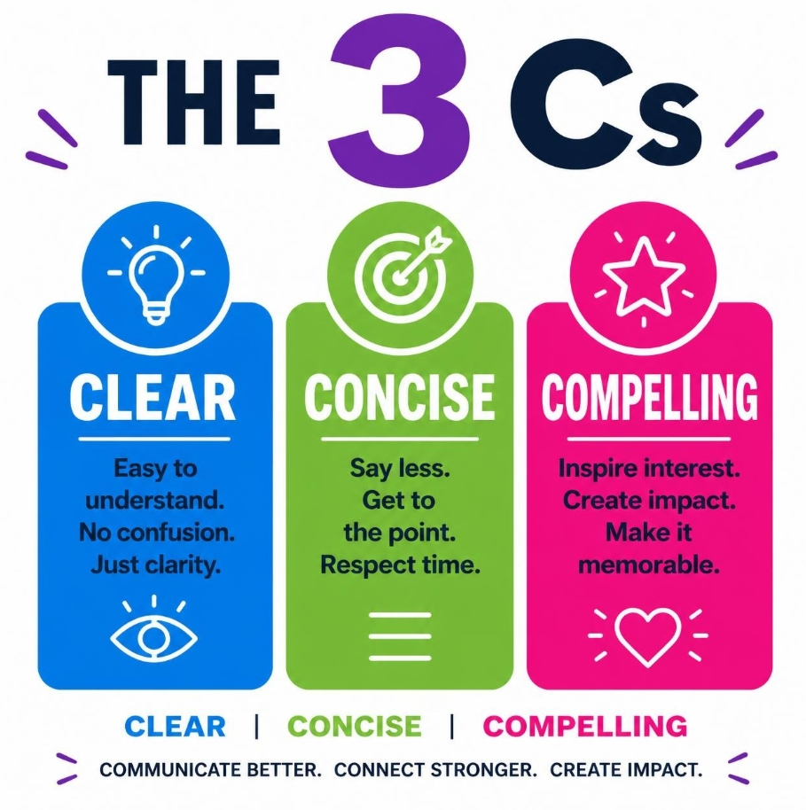
Notes:
No1 recommendation is to make good use of the guidance – it is detailed for a reason, because we would rather guide you to submitting a successful application, than send you feedback on how you might improve your next one. Of course, there are times when quality applications are still declined due to lack of funds, but the successful applications ultimately demonstrated sufficient evidence that met all the criteria.
We do not recommend that you complete your application online, we provide a word version so that you can create a draft document, then paste the content online when you have everything you need to submit.
When you’re drafting your application, remember the 3 Cs – be clear, concise and compelling!

Slide 10
Local Improvement Fund
£58,500
February/March 2027 – March/April 2028
Notes:
To summarise, we would like to provide up to ten grants of £5K or less, to begin delivering positive change by April 2027 at the latest and these may continue till March 2028. If you are able to get started sooner, we would prefer that, but we understand this may not always be possible.

Slide 11
funding@highlandtsi.org.uk https://www.highlandtsi.org.uk/li-fund
Notes:
All the details are online here and you can contact us on funding@highlandtsi.org.uk. Already available online, are the guidance document, FAQs, a sample application form which we recommend you use to draft your proposal, and please let us know if there’s anything else you would find useful.

