Slide 1

2026/27
Micro Grants opening 7 July 2026 for <£10,000
Communities Mental Health Fund Y6 | Highland Third Sector Interface (HTSI)
Notes:
The fund is distributed via TSIs (Third Sector Interfaces) covering each Scottish Local authority area, working with existing partnership groups, such as the CPP Mental Health Delivery Group and TSI delivery partners. In Highland, we are allocated just over £700K per year for third sector organisations. However, due to the Fairer Funding pilot which began last year, a number of organisations are now delivering multi-year projects which were granted for the first time. This of course, means that a significant portion of the fund has been ringfenced for these long-term projects. This equates to 62% of the funding we receive.

Slide 2

Overview
Background
Aims
At-risk groups
Application process
Outcomes
Reporting
Questions
Quality
Eligibility
Assessment
Notes:
These are the topics we intend to cover in today’s session … we’ll cover background, Eligibility, Aims, the At-risk groups and the Application process
….. Then we’ll go over some of the guidance on outcomes, quality, and how applications are assessed to help you make the most of the opportunity … and of course we’ve allowed time for questions at the end. The slides will be available on the webpage dedicated to this fund, and a recording of this session as well.

Slide 3
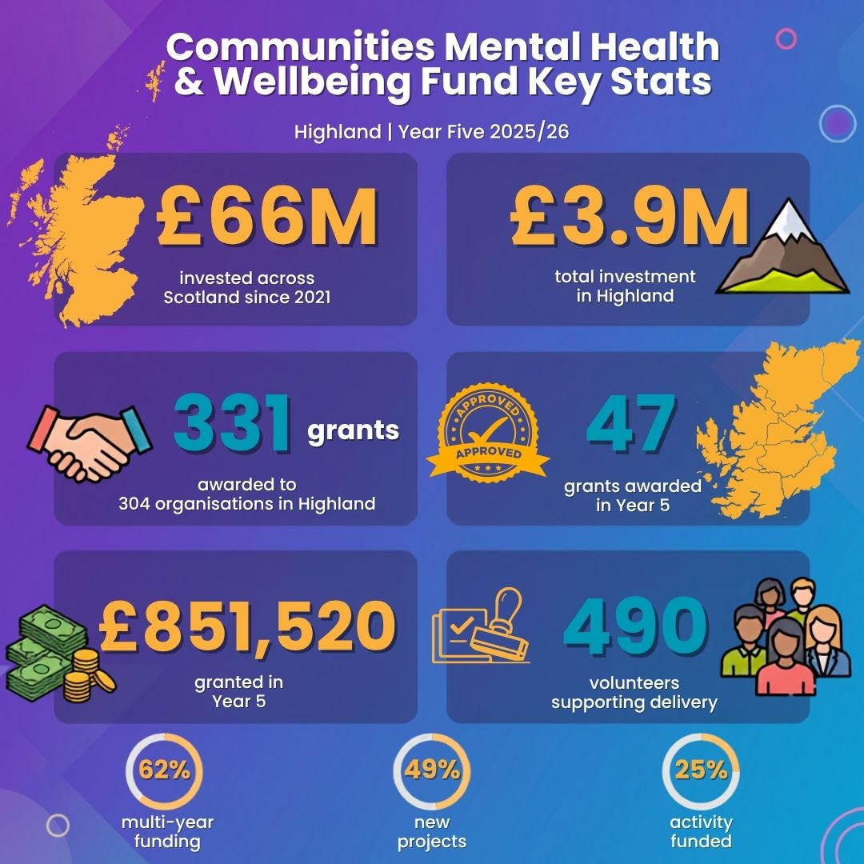
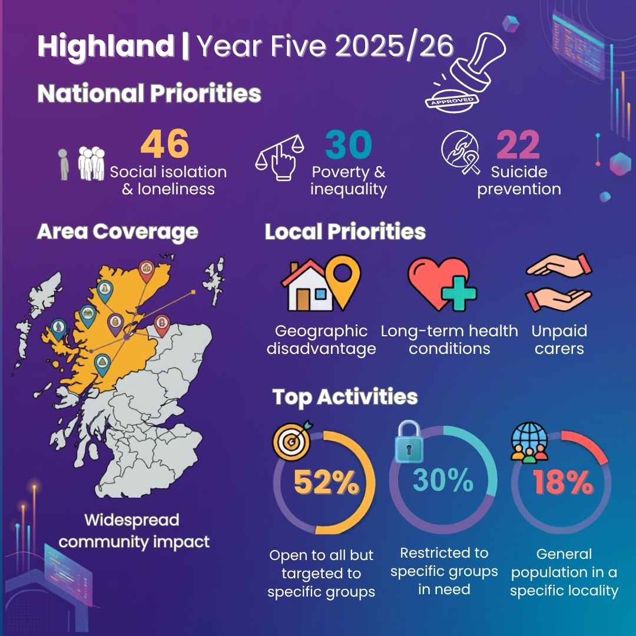
Notes:
The Communities Mental Health and Wellbeing Fund for Adults was established in October 2021 and to date has distributed around £66 million across Scotland to community initiatives supporting mental health and wellbeing. In Highland, we receive just over £700K to distribute to third sector orgs. Previously the money came from UK Government funds aimed at recovery from the impacts of the pandemic on mental health inequalities. But for the past couple of years, the funds have been coming direct from Scottish Government budgets, to assist in the delivery of outcomes from the Scottish Mental Health and Wellbeing Strategy. So, in Highland, we’ve invested £3.9M so far – in 331 grant awards to 304 organisations and/or partnerships.
Last year, we awarded 47 grants = £851,520 and the successful organisations estimated that this would involve 490 volunteers altogether. We were awarded additional investment towards the end of last year, which is why we distributed more than £700,000. As percentages of our allocation, 62% was invested in multi-year funding, 49% in new projects and only 25% of the amount requested could be awarded (the total requested by 147 application was £3,407,656). Full report available here Closing Report 2025-26.
As I said, the opportunity to grant funding across two years is part of the Scottish Government’s Fairer Funding pilot. The pilot has been set up to provide more certainty and allow for longer-term planning, aiming to improve stability and cost-efficiency for organisations and services. And we were allowed some flexibility to award a mix of 1 and 2 year grants last year, hence why we can still open these micro grants again this year, even though the bulk of our funds have been ringfenced for 2-years.

Slide 4
Who is eligible?
To promote mental health and wellbeing at a small-scale, grassroots, community level. A range of voluntary, not-for-profit, associations, groups, clubs or consortiums/partnerships with a strong community focus.
Scottish Charitable Incorporated Organisations (SCIO) | Cooperative and Community Benefit Societies
Companies Limited by Guarantee Trusts | Community Councils
Not-for-profit company, asset locked company or Community Interest Companies (CIC) | Parent Councils
Trusts
Notes:
The Scottish Government want to see these funds being targeted at a local level and so any small clubs or groups who may need support with the application process are encouraged to get in touch as early as possible. If you’re an Unincorporated Association, you will not be eligible to apply for a grant, but that doesn’t mean you cannot benefit from the funds - you may collaborate with an organisation which has the relevant legal structure which would help reduce liabilities. So, if this applies to you, you can contact us to discuss the support available. If considering a partnership, the lead applicant must be one of the organisations listed on this slide, and the UA would deliver the project in partnership.
While national charities and those with annual turnover equal to/above £1 million are not prohibited from applying, they will only be awarded a grant by exception. In other words, if you are a national charity or have high reserves or turnover, then you are expected to work with smaller community groups or grassroots initiatives, to access this fund. Or we would need evidence that there is no alternative. We also don’t expect to see applications for any Highland-wide service delivery proposals except where they apply to a specific and distinct thematic community. You need to clearly define the targeted community in your application. And although parent councils are eligible to apply, the activities must specifically focus on supporting adults rather than their children.
Most importantly, we are specifically looking for evidence that projects are influenced by direct participation with the intended beneficiaries – the people you aim to support – and their lived experience has helped shape the design, or the delivery is peer-led. It’s not enough to tell us that this is how you work, you need to describe how you achieve this and how this work has shaped your proposals.

Slide 5

Aims
Promoting good mental health and wellbeing and/or protecting against the impact of distress and mental ill health in adults
Supporting the resilience of communities and investing in their capacity to develop their own solutions
Tackling the social determinants of mental health, targeting resources & collaborating on initiatives to tackle poverty and inequality
Fostering a strategic and preventative approach to improving community health
Notes:
Alongside promoting good mental health and wellbeing, the fund also aims to foster a preventative approach to improving community health; enabling community resilience to develop our own solutions; and targeting resources, encouraging collaboration to tackle poverty and inequality, the social determinants of mental health.
As in previous years, the fund is targeting grassroots organisations, delivering small-scale projects, with an emphasis on their strong community focus.

Slide 6

What is eligible?
local community focus or thematic focus
both existing and new projects
increasing reach and accessibility
reaching seldom-heard, at-risk groups
time-limited projects, test of change, etc.
within the adult population (16+)
equipment
one-off events
hall hire for community spaces
small capital spend up to £5,000
staff costs (fixed-term)
training costs
transport
utilities/running costs
volunteer expenses
Notes:
On this slide, you can see the eligible costs on the right. Costs that are not permitted are detailed in the FAQs document, which you can download from the website. The fund is aiming to invest in new initiatives for adults over the age of 16, but we can fund existing projects if you are improving or developing the original project based on the views you’ve captured from participants and their lived experience, and if you are clear how you plan to reach more people (especially seldom heard, at-risk groups).
You will need to describe how you can ensure sufficient support to enable equal access and if relevant, demonstrate impacts from previous activities. However, success in year 5 won’t guarantee success in year 6.
Now the question of whether counselling is permitted within the guidance has been difficult to determine in the past, because this Fund is aimed at providing a range of preventative community supports for improved mental health and wellbeing – but it also aims to support early intervention approaches and support to those with existing mental health and wellbeing issues. So, the intention of the Fund is not about projects that are primarily “treatment” focused and it is not meant to replace funding for direct therapeutic interventions in the community, such as counselling, or CBT. Instead, it aims to provide a range of broader community supports that can complement clinical care and is an opportunity to support a wide range of approaches to providing emotional and practical support to individuals. As such, counselling and other therapeutic treatments are not excluded from the Fund, but will be considered on a case by case basis.
For the micro grants, your project can run for anything up to 12 months and we’ll be distributing the grant payments around end of August/early September, so we’d like projects to start as soon as is practical but by 31 March in 2027 at the latest. Obviously if you intend to apply again next year, you will need to be ready to wrap up this year’s funded activities, in order to apply for another grant next year. However, if your project experiences delays and it’s necessary to extend your activities, we can offer some flexibility within reason, but we do have reporting deadlines to comply with, for Scottish Government.

Slide 7
One grant programme:
Micro Grants for one year
Collaboration grants for two years (ringfenced)
Grants of up to £10,000 maximum
Grants of up to £50,000 maximum per year
Small Grants for two years (ringfenced)
Grants of up to £20,000 maximum per year
Notes:
In Highland, we have just over £700k each year to distribute for local, grassroot community activity that meets the local and national ambitions. However, we allocated two-year grant agreements for both the small grants and collaboration grant last year. So, this year we have ringfenced the multi-year components, which will be paid out for the second year of these projects. And we have a straightforward grants application process for projects that need £10K or less for one year. This opened today and you have until 13 Aug to submit an application.

Slide 8
Micro Grants £10,000 or less
Small-scale, community-led projects, to:
Tackle mental health inequalities, supporting a range of ‘at risk’ groups.
Address priority issues of social isolation and loneliness, suicide prevention and poverty and inequality.
Provide opportunities for people to connect with each other, build trusted relationships and revitalise communities.
Particular emphasis on responding to the cost-of-living crisis and support to those facing socio-economic disadvantage.
Notes:
The focus of the Fund is on prevention and early intervention, and For those of you who attended our annual conference last month, this will be a theme you’re well acquainted with. We would expect all funded projects to focus on one or both. In addition, you’re expected to describe your level of engagement with the community, and we’re looking for more than consultation – we are keen to see pro-active methods for involving people with lived experience in shaping delivery to respond to their needs.

Slide 9
Cost of living
The Fund also seeks to contribute to the following national outcomes from the National Performance Framework:
We are healthy and active
We will live in communities that are inclusive, empowered, resilient and safe
We tackle poverty by sharing opportunities, wealth and power more equally
Notes:
There will be a continued emphasis in Years 5 & 6 on responding to the ongoing cost of living crisis and on those facing socio-economic disadvantage, with a particular focus on supporting the six priority family groups identified under Best Start Bright Futures: Tackling Child Poverty Delivery Plan. Which is in addition to the at-risk groups on our next slide and young people aged 16-24 have been added as a priority group for the first time this year, due to rising concerns about mental health in this demographic.

Slide 10
At risk groups:
women (particularly women affected by gender-based violence)
people with a long-term health condition or disability
people from a minority ethnic background
refugees and those with no recourse to public funds
people facing socio-economic disadvantage
people experiencing severe and multiple disadvantage
young people aged 16–24
people with diagnosed mental illness
people affected by psychological trauma (including adverse childhood experiences)
people who have experienced bereavement or loss
people disadvantaged by geographical location (particularly remote and rural areas)
older people (aged 50 and above)
Lesbian, Gay, Bisexual, Transgender and Intersex (LGBTI) communities
people with learning disability, neurological and neurodiverse conditions
Notes:
The focus of the fund is on adults (16+) and on projects which help small geographic communities or thematic groups. The application will ask whether your approach will be for the whole population in a specific local area, or a particular thematic group. There will be a drop down where you can select the locality, but there’s also a question about neighbourhood or community. Ensuring equity of access and full participation from all relevant and at-risk communities is a priority of this Fund. However, the guidance also allows local decision making to reflect local priorities (as it has previously) and so other groups can be considered, which are detailed in a later slide. However, as tempting as it may be to tick all the boxes in an effort to appeal to the decision-makers, you can only select max 3 at-risk groups. And last year, a new at-risk group was added, identified here as people with a learning disability, neurological or neurodiverse condition. This year, as I said, young people aged 16-24 have also been added. And any groups that you do identify as a target for your project, you will need to give examples of additional measures you would employ to break down the barriers to inclusion.

Slide 11
National & Local Priorities
Suicide prevention
Social isolation and loneliness
Addressing poverty and inequality
Unpaid carers
Crisis prevention
Rural disadvantage
Psychological trauma
Long-term health conditions
Notes:
There’s no change to the national priorities, which are:
suicide prevention,
social isolation and loneliness, and
addressing poverty and inequality.
There’s only one local priority, which is not already covered within at-risk groups. So, we know that many applicants identify rural disadvantage as a key issue, but this can be identified as a priority group. The same goes for e.g. people experiencing psychological trauma, long-term health conditions, etc. Whereas support for unpaid carers is the only local priority, which is not already covered in the at-risk groups.

Slide 12
Micro Grants Process
Opens 7 July 2026
Closed MIDDAY 13 August
Panel in September
Notes:
The application portal opened today (7 July) and you must submit before the deadline at MIDDAY on Thursday 13 August. The panel meeting date is yet to be determined, but is usually about four weeks after the closing date, which allows time for due diligence checks and assessment by the independent panel.
The application form will remain very similar because the Scottish Government still require the same amount of detail on your organisation, your project, who you are targeting and how you will measure success. All application forms are accessed via a hyperlink on our website which takes you to JotForm. You must follow the guidance throughout the application process and include all relevant information first time, because we won’t have the opportunity to return to the panel for decisions. We will provide a sample form, designed for you to create a draft application before you submit online.
Once awards have been decided by the panel, we will notify both successful and unsuccessful applicants of their decision. We aim to provide constructive feedback to all applicants who are denied a grant, to help you with future applications. Should you apply, there is an expectation that you will keep track of the timescale and set a reminder for when you might reasonably expect to hear back from us. If you have not received our email, as expected, please check your spam folder as it may have been redirected. But if you still can’t find it, please don’t hesitate to drop us a line and ask for the results. The timeline detailed here is published online and will remain online throughout the process for your reference. When we have confirmed panel meeting dates these will be added to the same timeline, so you will know exactly when the decision making is due to take place.

Slide 13
Outcomes: what difference do we make
What is the problem/ situation that our service is seeking to address?
What would success look like?
What are the changes we are hoping to see in our participants?
How can we measure that change?
Notes:
Your application must clearly outline how the project will benefit the mental health and wellbeing of people in your community. It is essential that you can detail how you involved your community in establishing the need and how this engagement helped to determine that your proposed activity would likely meet that need.
We will schedule a group support session for anyone who would like a closer look at the application questions and talk about how you can make the best case for your project. If you need support to consider your proposal, answer questions, etc, please attend this session or contact us as soon as possible. Third Sector Human Rights & Equalities https://thre.org.uk/ Thre) can provide online training on a human rights approach to funding, so please visit their website if that’s something you’d like to know more about.
It’s important to remember that outcomes in the funding context are the changes you want to see in your participants, and not confuse these with outputs, such as number of participants or number of group sessions. Too often, we focus on attendance and feedback, ie. anecdotal evidence without asking the relevant questions that indicate positive changes people experience. Once you’ve identified the right outcomes, that will make it much easier to see what your indicators of success should be, ie. changes you can observe or gather from participants and provide meaningful evaluation.
We cover this in more detail in our training sessions on Engagement, Evaluation & Funding. We held a session in March and the next one is scheduled for 27 August, so if you feel that would be useful, please check out our membership benefits via Very Connect.

Slide 14
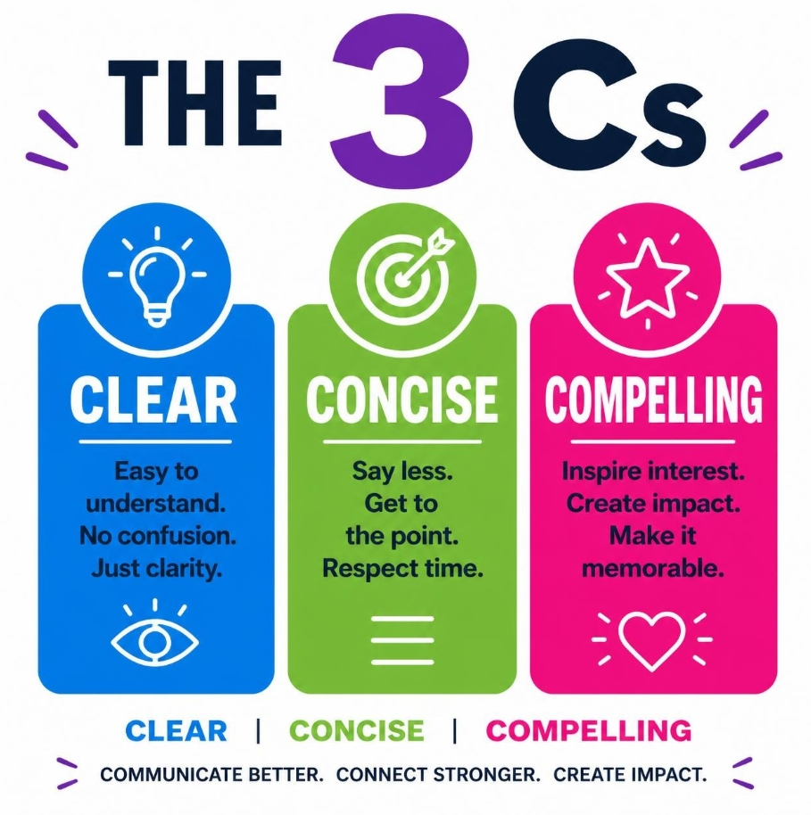
Notes:
To submit a good quality application that scores well against all the criteria, it’s crucial to remember the 3 Cs – be clear, concise and compelling. To help the panel understand what would be provided for the investment, be specific about what is involved, use simple straightforward language, make the information accessible by using paragraphs with spaces between them and clear headings also helps. You can use bullet points but remember the guidance for these things – no more than 5-7 bullet points or it defeats the purpose. The guidance and FAQs includes suggestions for reducing your word count without losing the meaning. You may have tonnes of ideas but stick to one clear priority – what’s achievable and will closely match the aims of this fund – don’t lose focus on your target. Clearly articulate the difference this will make – not for your organisation but for people in your community.
Our panel members sometimes report being puzzled at project descriptions which only give half the picture, or are confusing. On the form, the project description is required at Q14 and it’s restricted to 100 words which is dictated by SG. The question states: Please describe the project including its key aims and activities and how this supports mental health and wellbeing. To make this clear, you can break this section down into separate statements that cover the activity, timing, number of sessions, estimated number of participants, etc. For example, here’s one we received in a previous year, which states: “We will improve mental health and wellbeing targeting loneliness and isolation during the winter months by bringing people together through social events and activities. We will deliver 6 monthly evening/weekend events with activities and food. Eg. ceilidh, quiz night, games night and karaoke, from November to April. To enable attendance we will work with our community transport provider.” The important thing about this example is that it’s specific, it’s concise and therefore very clear and easy to understand. But it also addresses everything that was asked for, so remember to stay focused on answering the questions and be specific and concise.

Slide 15
Overall quality of application
competency, clearly defined, demonstrating ability to deliver
connections, local presence /previous experience
good standing (governance, reserves, stability, etc)
Project definition
activity appropriate and linked to support for MH&W
project aims are clearly articulated
financial breakdown is realistic and sustainable
outcomes are clearly defined and measurable
Collaboration and involvement
connections with/ involving beneficiaries
need identified via local connections
engaging participants in measuring success
engaging community /relevant stakeholders
Fits with principles
grassroots, small-scale, community focused
tackling inequalities is evident
evidence of plan to demonstrate impact
building on capacity, local strengths and meets priorities
timeline matches funding parameters
Notes:
Applications will be assessed across four areas of competency on an equal basis, each forming 25% of the final score. Each member of our independent panel are tasked with providing a score on each of the 16 elements on this slide. This is why we ask that you closely follow the guidance and refer to the criteria, in order to submit the required reassurance.
Overall quality of application, project definition, collaboration, involvement and how well it fits with the fund’s principles.
If you’re not sure what a question means, please ask – alternatively put yourself in the position of investor – what would you want reassurance on if you were being asked to fund something. And if you come across a question that appears at first glance to be asking exactly the same as another, go back and read both questions again carefully. None of the questions are duplicates, so it’s possible that you’ve just misconstrued what was being asked for. And if you got carried away in another section and explained something that had nothing to do with the question, please move it to the correct section before submitting it.

Slide 16
Awards
Funding agreement
Progress Report halfway
Closing Report
Promoting Activities & Impact
Notes:
As you will expect there are some requirements that come with this communities funding, beginning with a funding agreement. So, if you’re awarded a grant, we’ll send you a funding agreement which includes the terms and conditions of the grant, which you must sign and return to us with your bank details before we can make payment. After that, we need to collate progress reports around the mid-point of your activity. Projects will have different timelines, depending on their planned duration, but all grant recipients must submit a closing report at the end – but this should not be completed until you’ve spent all the grant monies. If for any reason, it looks likely that you’ll have funds left beyond the planned end date, you must contact us to discuss this at the earliest possible opportunity. The progress reporting period at the halfway point, is the best time to check on your budget and forecast any likely underspend. It’s also a timely reminder of your intended outcomes and to check in with your monitoring and evaluation. And as your planned outcomes and methods for measuring these will be part of your application, thus built into your project, this shouldn’t be an onerous task. However, before you apply, there are lots of free resources we can direct you to that can help you determine how to evaluate your project, so please just ask about these resources.
If you receive a grant, it is your responsibility to keep track of the amount you’re paid, the date it was paid to you, the end date by which you are expected to report back your results and the reporting methods, which we will share with everyone who is successful. If you’re working in partnership with others, be sure to share the reporting schedule with them as well, so that they can provide any data required on time. However, this emphasis on reporting doesn’t mean that we expect glowing reports of 100% success from you, it’s completely natural to encounter challenges along the way, and your report is designed to capture this along with any learning points. So, while it’s important to have measurements in place to identify achievements, it’s also important to capture learning and how you dealt with challenges, because you will be asked about this and it’s extremely useful to help you develop your activities.
Scottish Government have specifically asked that projects promote their activities on ALISS (A Local Information Service for Scotland), as well as any local signposting tools/websites. ALISS is a national digital platform, enabling people to find (and share) information on services, groups, and support in local communities. Remember that resources on ALISS are also fed into the Scottish Services Directory on NHS Inform and other national helplines or databases (who rely on ALISS or Scottish Services Directory for up-to-date information).

Slide 17
Questions
Notes:
We’ve covered:
Who and what is eligible
Aims and both National and local priorities
Application process
At-risk groups
The 3 Cs and the assessment criteria
Outcomes and the reporting required if successful
REMEMBER TO:
Read the guidance and have it close to hand when completing your draft application
Pay very close attention to what the question is asking for, it may be more than one thing so don’t forget to check you’ve said everything that’s required – but provide too much and you’ll make it difficult to follow
Pay close attention to the aims of the fund, read the reports from previous years to see who and what was funded previously
Be clear and concise in describing your activity and how it will benefit people
Be specific and don’t lose focus by combining different activities/priorities into one application
If you choose a target group, you must have evidence of engagement and describe additional measures to include them
Focus on defining appropriate outcomes for participants – orgs don’t have outcomes, people do! Outcomes are not Outputs
Leave appropriate time for proofing, formatting, and checking your finances are correct – panel will spot errors a mile away and if funds are oversubscribed, don’t provide any excuse to dismiss your proposal
Collaborate and engage with others for better value, more effective outcomes, and increased learning and development.

